Slide 1
HW SW Co-Design
Students: Bar Arama & Tomer Ben-Arush
Semester: Spring 2025

Slide 2
Overview
Logging
Json Dumps
Overview
Performance Analysis
Algorithm performance Improvement
Hardware accelerator
Conclusion

Slide 3
Logging
Notes:
ברק

Slide 4
Logging - overview
The Creation process of a message log
Start logging creation
Check who called for the log creation
Check who is the consumer for the log
Insert the log into the correct format
Send Log to network/StdOut, etc

Slide 5

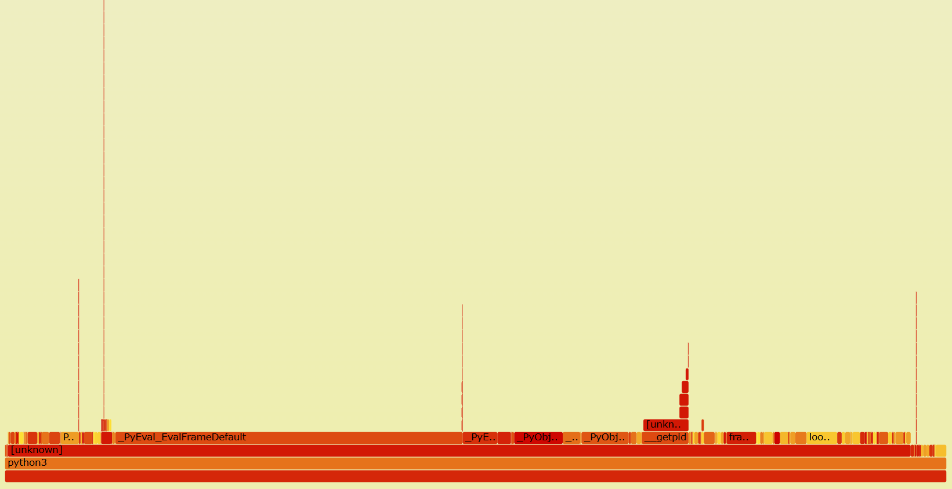
Performance Analysis

Slide 6
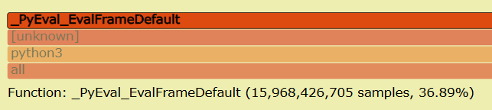
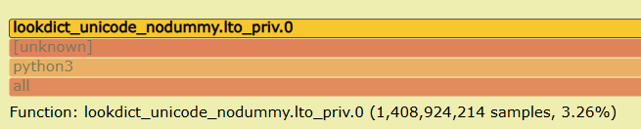
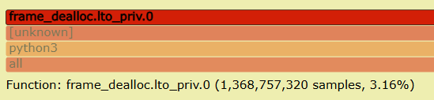
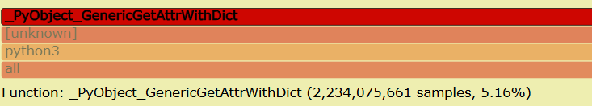
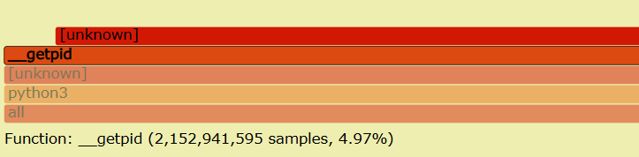
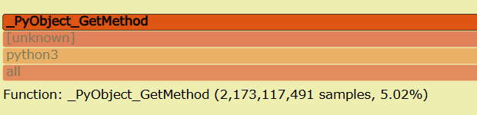
Performance Analysis
bytecode interpreter loop
Name and attributes mapping
Memory allocation
Pid recognition
Formatter build

Slide 7
Performance Improvements
Recognize bottlenecks and repetitive operations
Recognize unnecessary actions
Keeping identical output
Key Actions
Adaptive fields
PID caching
Fast-path for repetitive get_message operation
Handler chain caching

Slide 8
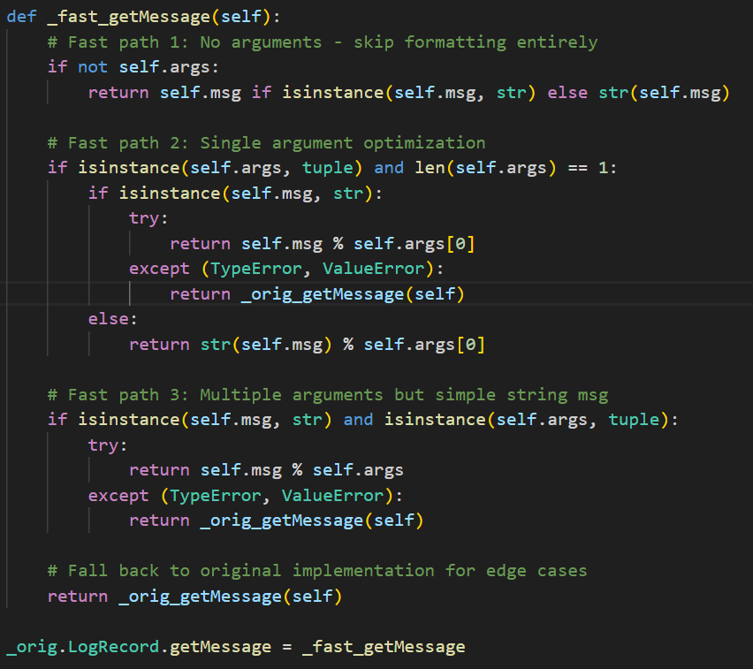
Performance Improvement
Fast message formatting

Slide 9

Performance Improvement
Cached Pid

Slide 10
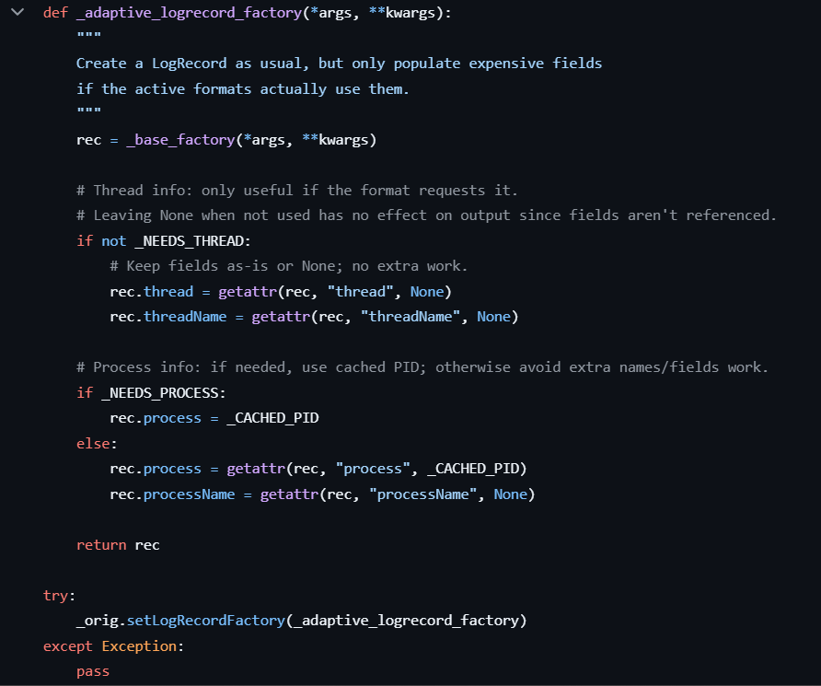
Performance Improvement
Adaptive fields

Slide 11
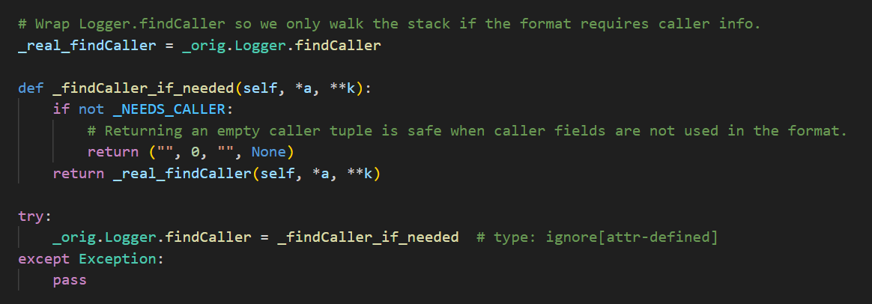
Performance Improvement
Adaptive fields

Slide 12
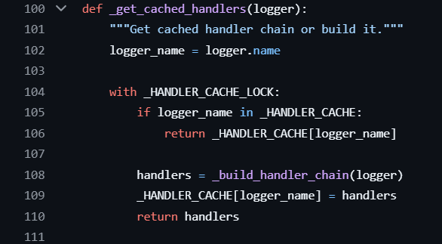
Performance Improvement
Handler Caching

Slide 13
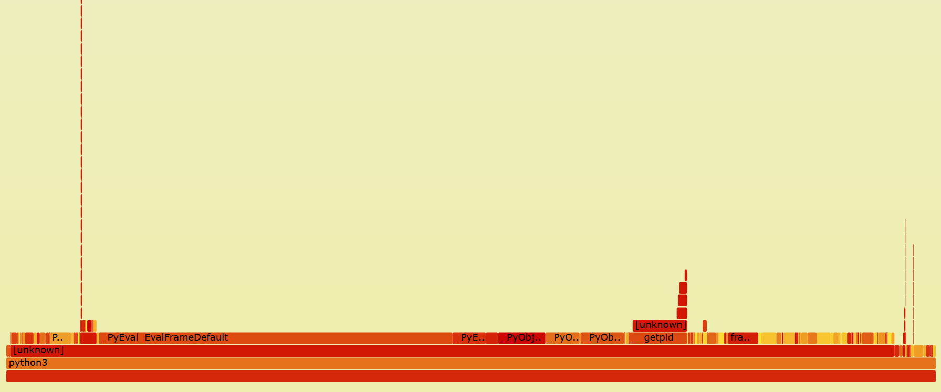
Performance Improvement

Slide 14
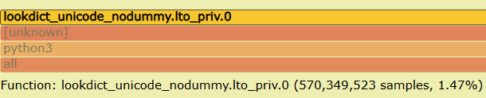
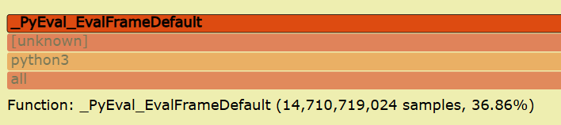
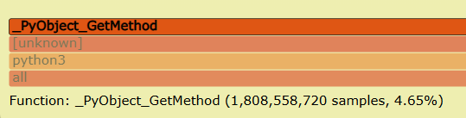
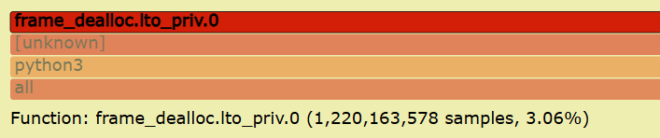
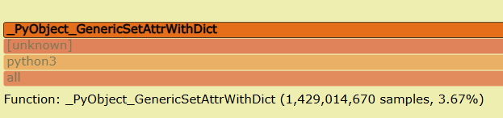

Performance Analysis
Name and attributes mapping 3.26%>1.47%
bytecode interpreter loop
$$16⋅{10}^{9}>15⋅{10}^{9}$$
Memory allocation
3.16%>3.06%
Formatter build
5.02%>4.65% 5.16%>3.67%

Slide 15
Hardware accelerator – Critical Points
Python Interpreter as a critical bottleneck.
Repetitive function calling.
Most of the log creation occurs inside the CPU.
Different Log types with the same priority.
CPU Log Creation steps:
Fetching metadata (pid, timestamp, etc.)
Formatting string + args
Allocating + copying memory
Syscall to write

Slide 16
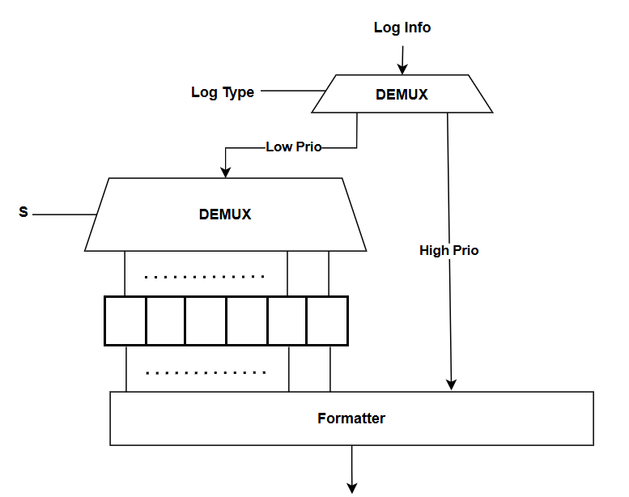
Hardware accelerator
Logging Optimizer
Log Id and type, PID, Destination
Prioritize and allocate memory
Formatting
Send to destination
CPU
Hardware
Using MMAP for shared memory location.
Handling formatting
Prioritize Logs.
Input: Log info and Type.

Slide 17
Hardware accelerator
Performance analysis
Software System
Time Reading – 350 ns
Formatting - 500 ns
Sending – 1000 ns
Total: 1850 ns
Software & Hardware System
Time Reading – 20 ns (using internal clock)
Formatting – 5 ns (Using ROM tables)
Sending – 1000 ns (HW ONLY)
Total: 1025 ns
Only Software Full log creation: 2000 ns SW & HW : 1175 ns
More than 40% Faster
*Presenting only software-affected calculations
*Presenting performance assessment

Slide 18
Conclusions
Logging

Slide 19
Conclusions
A small change in repetitive actions can create a large effect.
Sometimes an unnecessary operation can be the main (and silent) consumer.
Hardware integration can create another architectural feature.

Slide 20
Json Dumps

Slide 21
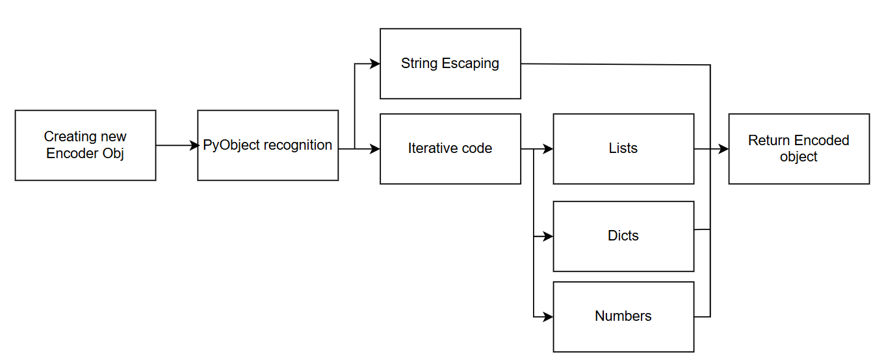
Json Dumps - overview
Taking a Python Object and converting it to a JSON file

Slide 22
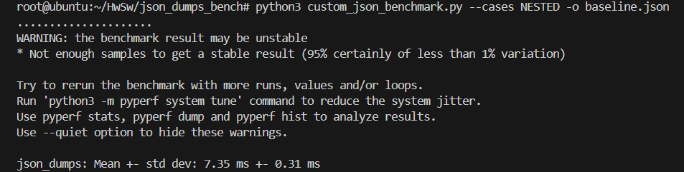
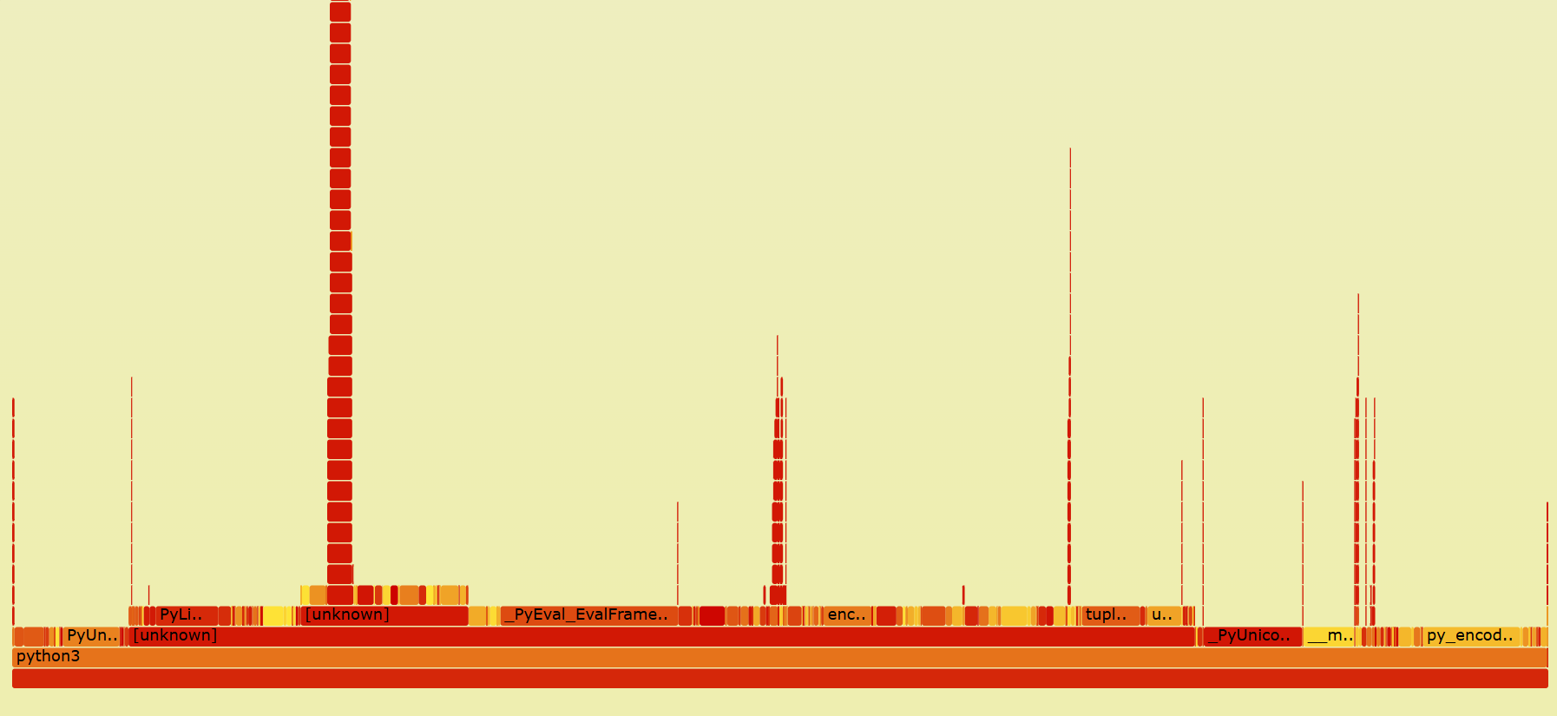
Performance Analysis
*Based on Nested case

Slide 23
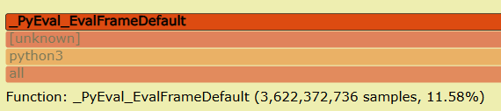
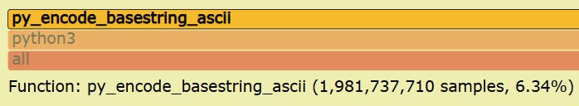
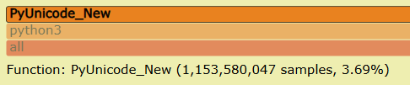
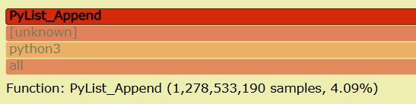
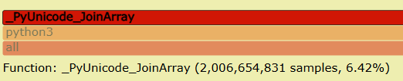
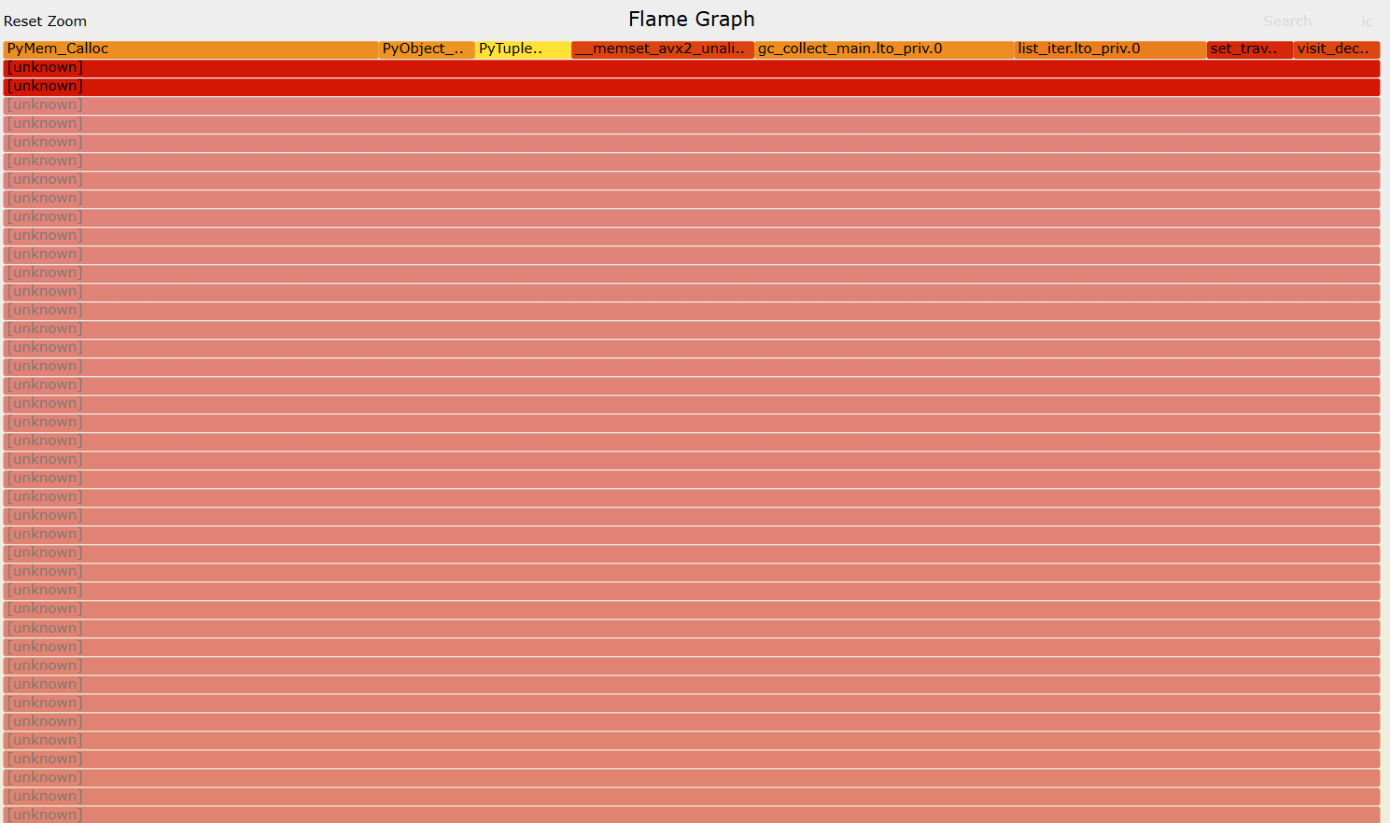
Performance Analysis
String Escaping
bytecode interpreter loop
String Objects creation
Collection Serialization
Collection Serialization
Stack
over usage
*Based on Nested case

Slide 24
Performance Improvements
Python interpreter as a main consumer
Collections serialization is a main bottleneck
Repetitive actions – encode the same input again and again
Keeping identical output
2-way solution
Optimized_json
Fast-path recognition
Caching collections
Compact separators
Fast_json
Orjson Rust library
Compiled lib
Better Memory Management

Slide 25
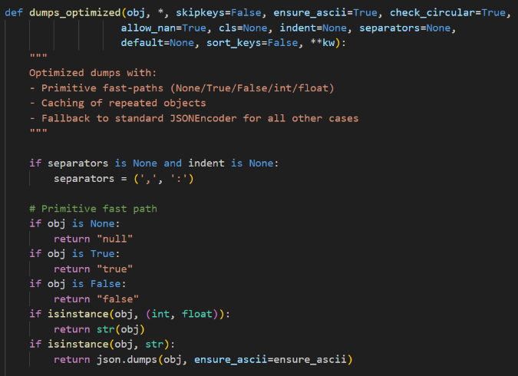
Performance Improvement
Fast Path Recognize

Slide 26
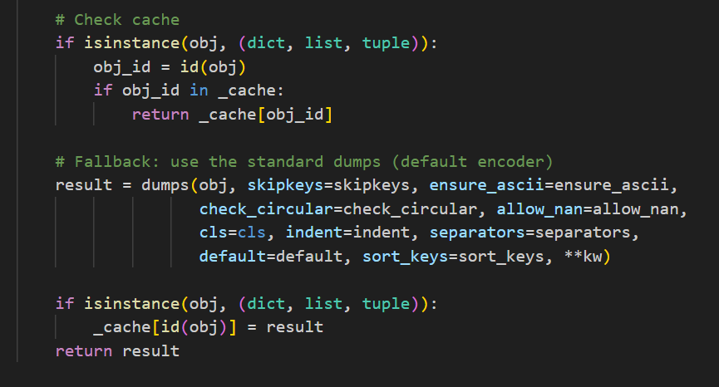
Performance Improvement
Cache usage

Slide 27
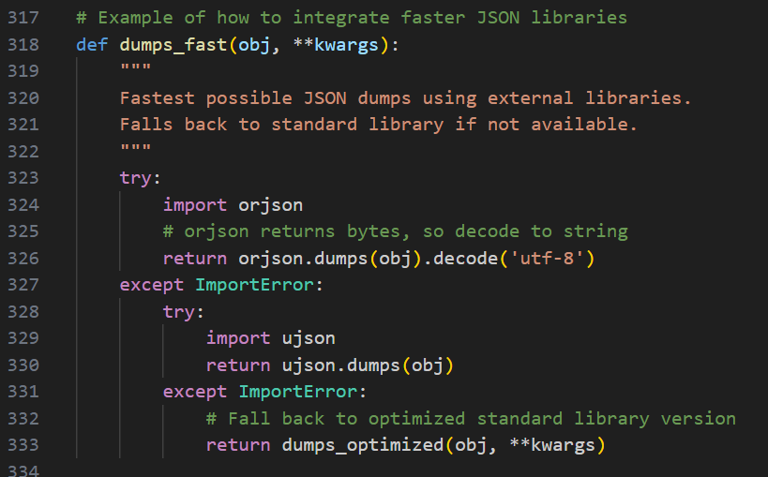
Performance Improvement
OrJson Lib Usage

Slide 28
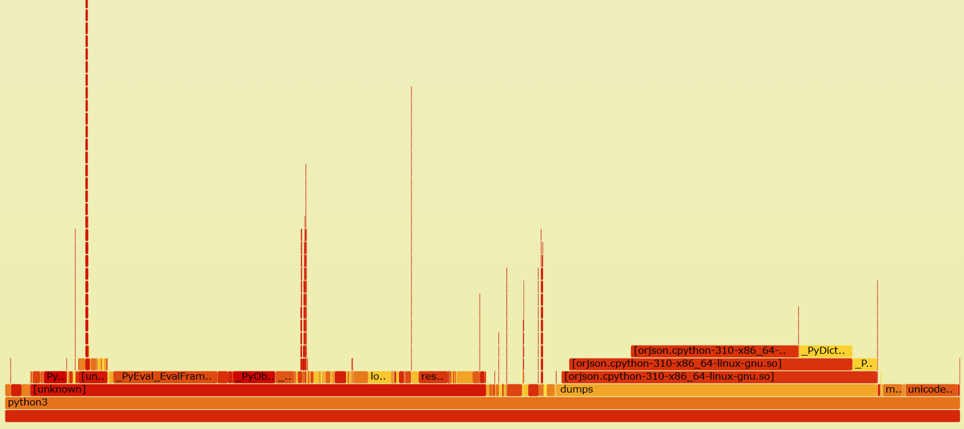
Performance Improvement
Fast
*Based on Nested case

Slide 29
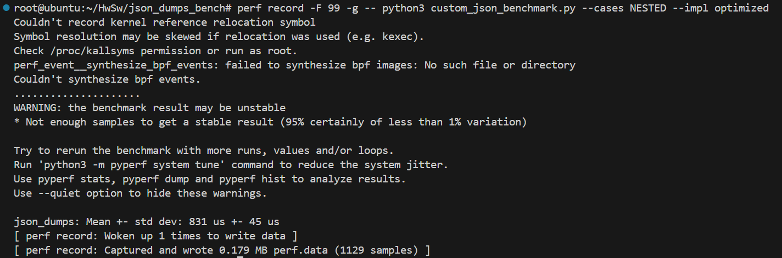
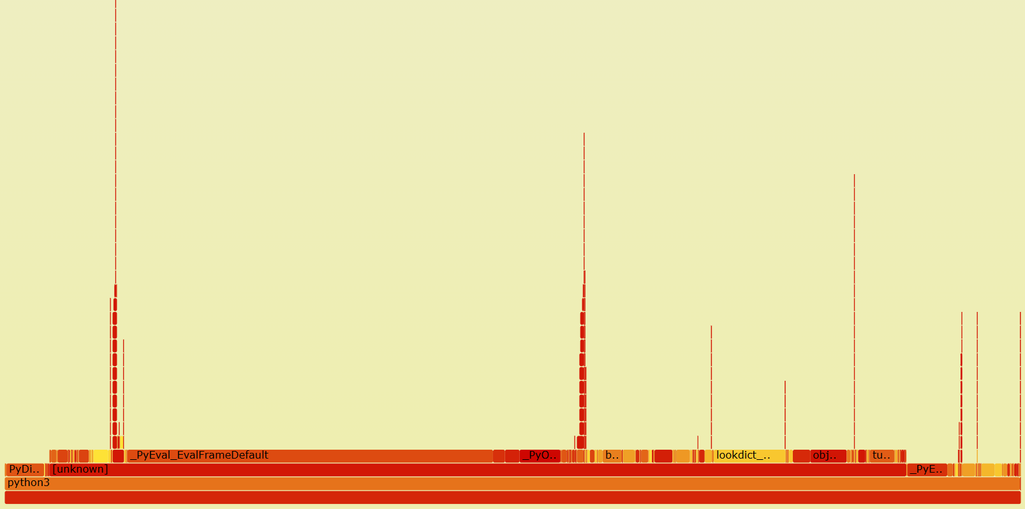
Performance Improvement
Optimized
X8.85
*Based on Nested case

Slide 30
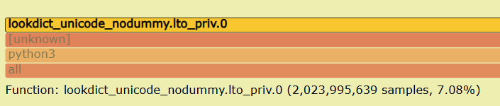
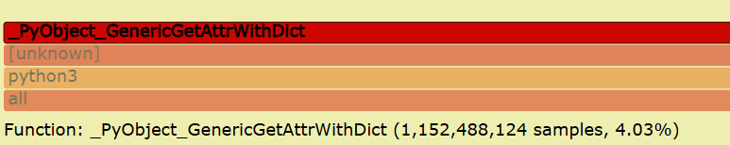
Performance Analysis
Specially for the Cached Dictionary
Increase in Get Attribute Due to Cache usage
Decrease of:
String Escaping
Collections Operations
*Based on Nested case

Slide 31
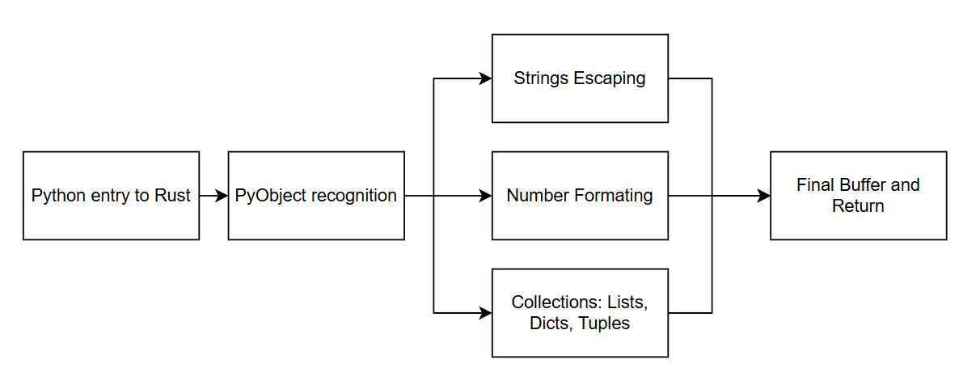
Hardware accelerator
Orjson algorithm main blocks
HW Disadvantage
HW Advantage
Starting Point:
Using DMA Via PCIe-3 protocol.
HW accelerator input is Pointer and length.
*Orjson Function is total 30% of the running time

Slide 32
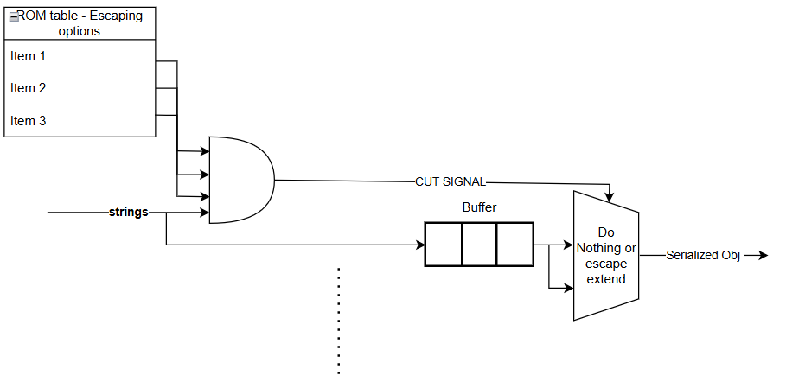
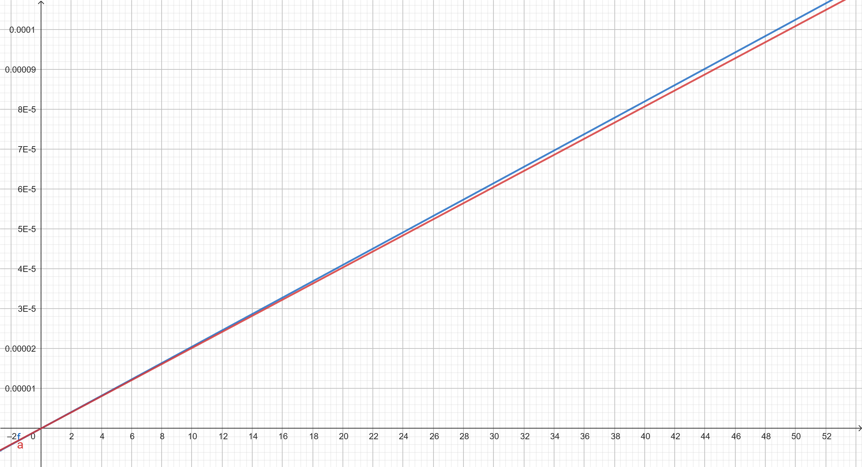
Hardware accelerator
String Escaping
File Size (kb) VS Time (sec)
For a 32 KB string:
Software performance ~65.5us
Hardware acceleration performance ~64.5us
total of 2% improvement, best-case implementation

Slide 33
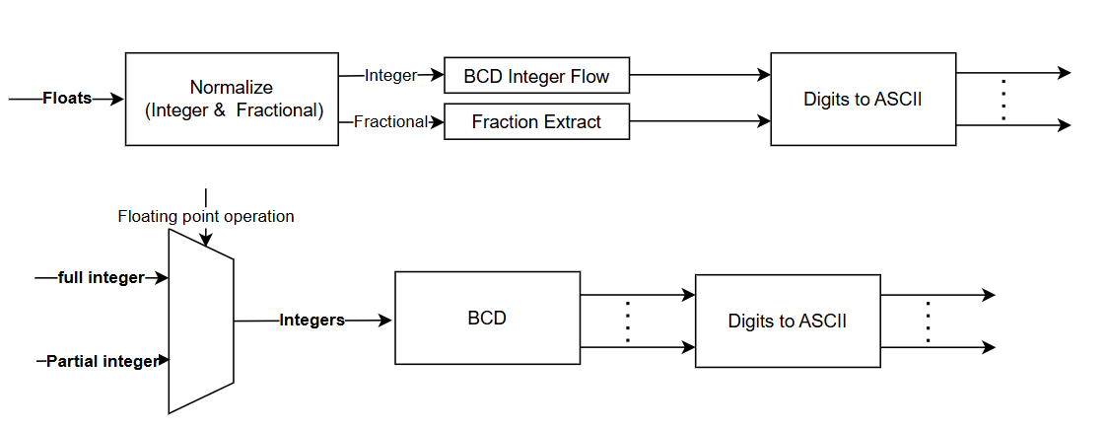
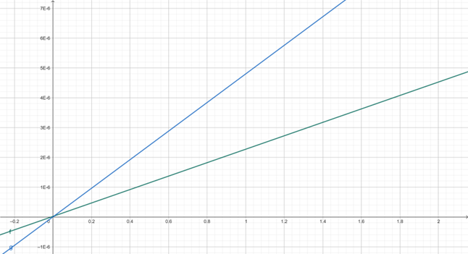

Hardware accelerator
Number Formatting
For a 32 KB floating-point file:
Software performance ~153.6us
Hardware acceleration performance ~72.2us
Almost 212% improvement, best-case implementation
File Size (kb) VS Time (sec)
Amdahl’s law speed up:
$$speed up=\frac{1}{0.3⋅\frac{0.5}{2}+0.7}\sim 1.3$$

Slide 34
Conclusions
Json Dumps

Slide 35
Conclusions
The Solution has a dependency on the algorithm and the Input to it.
Smart cache usage as a key for software acceleration.
Hardware integration should be tested in various aspects – not just speed.

Slide 36
Thank you! Questions?

